Slide 1




SAVEETHA SCHOOL OF ENGINEERING SAVEETHA INSTITUTE OF MEDICAL AND TECHNICAL SCIENCES
CSA0697 DESIGN AND ANALYSIS OF ALGORITHM FOR LOWER BOUND THEORY
Minimizing Assignment Groups with Greedy Techniques
BY:
NAME : Mansi Beura
REG.NO: 192210488
FACULTY NAME:
Dr. Gnana Soundari

Slide 2

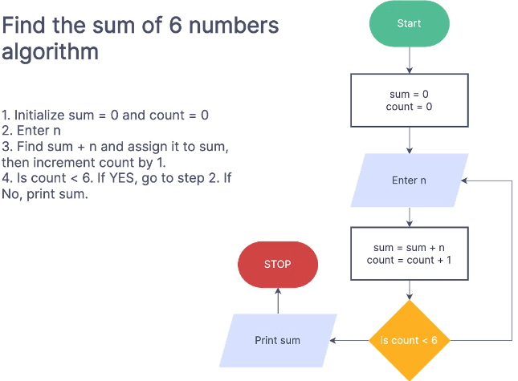
Greedy Technique Overview
The greedy approach is a problem-solving technique that makes locally optimal choices at each step, hoping to arrive at a globally optimal solution.
1
Step-by-Step Decisions
2
No Backtracking
The greedy algorithm focuses on making the best decision at each step, considering only the current state.
Once a decision is made, it is not reconsidered, even if a later decision reveals that it was suboptimal.
3
Simplicity and Efficiency
4
Potential for Suboptimality
Greedy algorithms are often simple to understand and implement, providing quick solutions in many cases.
While often efficient, the greedy approach doesn't guarantee the absolute best solution for all problems.

Slide 3


Problem Statement and Constraints
The Minimum Number of Groups problem involves assigning tasks or assignments to groups, with each group having a specific capacity limit.
Assignment Properties
Group Capacity
Each assignment has a specific weight or size, representing the resources required to complete it.
Each group can hold a maximum amount of assignments, defined by its capacity.
Valid Assignment
A valid assignment means all assignments are allocated to groups, and the total weight of assignments in each group does not exceed its capacity.

Slide 4


Sorting the Assignments
The first step in the greedy approach is to sort the assignments in descending order of their weight or size.
1
Sorting Criteria
Sorting assignments by descending weight allows the algorithm to make the most efficient grouping choices.
2
Impact on Groups
Sorting ensures that the heaviest assignments are considered first, reducing the chance of exceeding group capacity later.
3
Greedy Advantage
This sorting step enables the algorithm to prioritize assignments that require the most resources, making it easier to achieve a valid allocation.

Slide 5


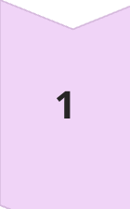
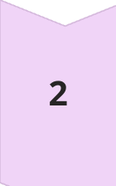
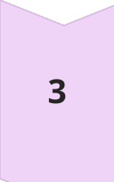
Assigning Assignments to Groups
Once the assignments are sorted, the greedy algorithm iterates through them, assigning each to the group with the most remaining capacity.
Group Selection
The algorithm selects the group that can accommodate the current assignment without exceeding its capacity.
Assignment Placement
The assignment is placed in the chosen group, and the group's remaining capacity is updated.
Iteration and Allocation
This process continues until all assignments have been successfully allocated to groups.

Slide 6


Calculating the Minimum Number of Groups
The Minimum Number of Groups problem involves finding the smallest number of groups to accommodate a set of assignments, ensuring that each group meets specified constraints.
After all assignments are placed, the minimum number of groups required for a valid allocation is simply the total number of groups used in the process.
Minimum Groups
Number of Groups Used

Slide 7
Time Complexity Analysis
The time complexity of the greedy approach is dominated by the sorting step, which typically takes O(n log n) time, where 'n' is the number of assignments.
Sorting
Assignment Allocation
Overall Complexity
Sorting the assignments is the most time-consuming operation in the algorithm.
Assigning assignments to groups takes linear time, O(n), as each assignment is considered once.
Therefore, the overall time complexity of the greedy algorithm is O(n log n), dominated by the sorting step.

Slide 8





Space Complexity Analysis
The space complexity of the greedy algorithm is primarily determined by the space required to store the sorted assignments and the group capacities.
Sorting
The algorithm typically requires additional space for sorting, which can vary depending on the sorting algorithm used.
Group Data
The algorithm also needs space to store group capacities and the assignments allocated to each group.
Overall Space
The overall space complexity is typically O(n), where 'n' is the number of assignments, assuming efficient data structures are used.

Slide 9


Advantages of the Greedy Approach
The greedy approach offers several advantages for the Minimum Number of Groups problem, making it a practical and efficient solution.
1
Simplicity and Implementation
2
Efficiency for Large Datasets
The algorithm is easy to understand and implement, requiring minimal code complexity.
The time complexity of O(n log n) makes it suitable for solving problems with a large number of assignments.
3
Practical Applicability
The greedy approach provides a reasonable solution in many real-world scenarios where finding the absolute minimum is not critical.

Slide 10

Conclusion and Key Takeaways
The greedy technique offers a practical and efficient solution to the Minimum Number of Groups problem, providing a way to minimize the number of groups while ensuring a valid assignment.
In conclusion, the problem of grouping indices to achieve valid assignments while maintaining balanced group sizes presents both challenges and opportunities for optimization. By leveraging frequency counting and distribution strategies, we can effectively address practical constraints in various domains such as load balancing, resource allocation, and real-time data processing. Continued advancements in algorithm design and the application of these techniques to complex and dynamic systems will enhance our ability to manage and optimize data and resources efficiently, paving the way for more robust and scalable solutions across diverse fields.
Future Scope
The future scope of the topic involving grouping indices to form valid assignments includes enhancing algorithms to efficiently handle large-scale and real-time data, optimizing resource allocation and load balancing in distributed systems, and exploring advanced constraints and hybrid approaches. These advancements can improve performance in dynamic environments, support complex systems such as network traffic management and scheduling, and extend applications to areas like machine learning for clustering. Continued research in these areas can lead to more effective and scalable solutions in diverse practical scenarios.
Key Points
Sorting assignments in descending order, prioritizing resource-heavy tasks, and iteratively assigning to groups with the most remaining capacity are crucial aspects of the greedy approach.

